Slide 1
Lambda Locally
Hieu Nguyen

Slide 2
Agenda
Kinesis Overview
Lambda Overview
Debug Lambda Locally
Q&A

Slide 3
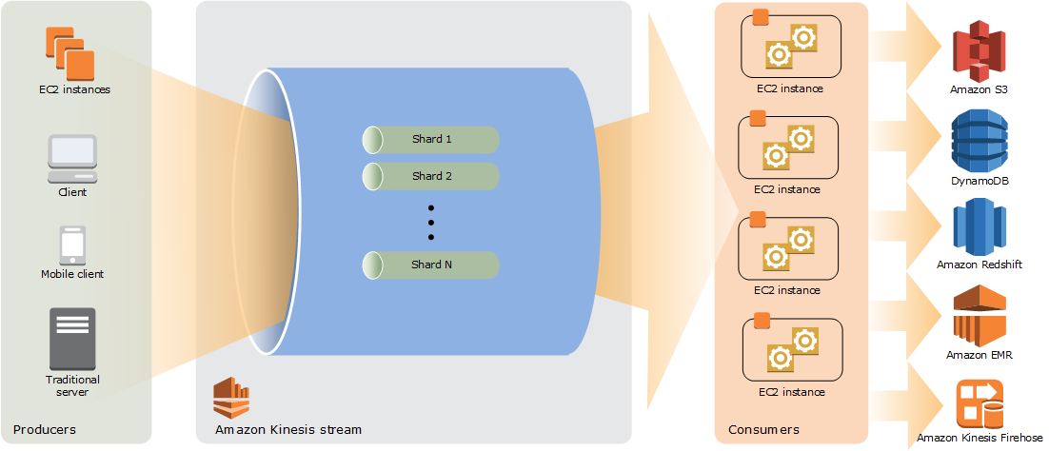
Kinesis Overview

Slide 4
Kinesis Data Streams Terminology
Kinesis Data Stream is a set of shards. Each shard has a sequence of data records. Each data record has a sequence number that is assigned by Kinesis Data Streams.
Data Record is the unit of data stored in a Kinesis data stream. Data records are composed of a sequence number, a partition key, and a data blob, which is an immutable sequence of bytes
Retention Period is the length of time that data records are accessible after they are added to the stream
Producer: Producers put records into Amazon Kinesis Data Streams
Consumer: Consumers get records from Amazon Kinesis Data Streams and process them
Shard is a uniquely identified sequence of data records in a stream

Slide 5
Serverless
Serverless computing is an execution model where the cloud provider is responsible for executing a piece of code by dynamically allocating the resources.
Serverless is sometimes referred to as “Functions as a Service” or “FaaS”
Major cloud providers: AWS Lambda, Azure Functions, Cloud Functions, etc.

Slide 6
AWS Lambda concepts
Function is a resource that you can invoke to run your code in AWS Lambda. A function has code that processes events, and a runtime that passes requests and responses between Lambda and the function code.
Qualifier: When you invoke or view a function, you can include a qualfier to specify a version or alias
Runtime: Lambda runtimes allow functions in different languages to run in the same base execution environment. You configure your function to use a runtime that matches your programming language
Event is a JSON formatted document that contains data for a function to process. The Lambda runtime converts the event to an object and passes it to your function code
Concurrency is the number of requests that your function is serving at any given time
Trigger is a resource or configuration that invokes a Lambda function

Slide 7
AWS Lambda metrics to monitor
Function utilization and performance (Duration, Billed duration, Memory size, Max memory used, Errors)
Invocations (Synchronously, Asynchronously, Event source mapping)
Concurrency (concurrent executions, unreserved concurrent executions,
Provisioned concurrency usage (Provisioned concurrency spillover invocations, Provisioned concurrency utilization, Provisioned concurrency invocations)

Slide 8
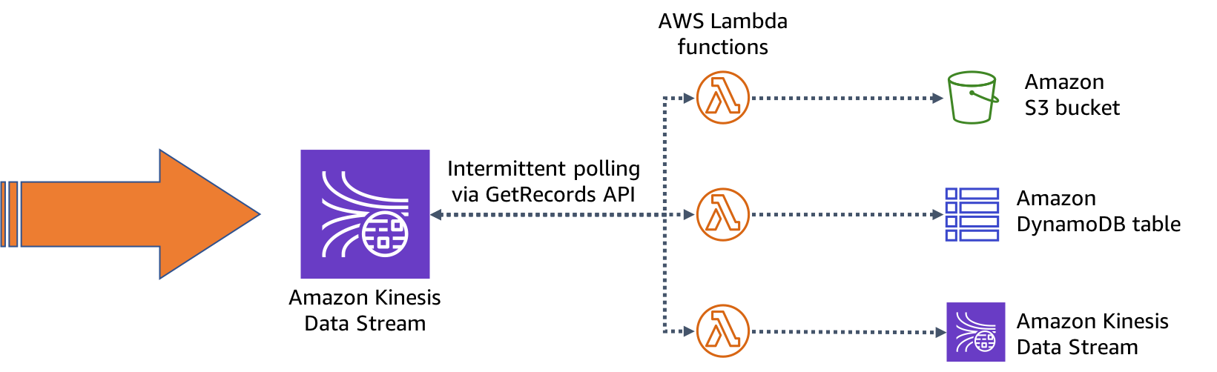
AWS Lambda and Kinesis

Slide 9

Q&A
“If you have any questions, please keep it for yourself. I'm not Google”

